Slide 1
Modular Arithmetic

Slide 2

Set of Integers (z)

Slide 3
Modulo Operator
Find the result of the following operations:
27 mod 5
36 mod 12
−18 mod 14
−7 mod 10

Slide 4
Modulo Operator
27 mod 5 27/5 gives remainder =2
36 mod 12 36/12 gives remainder =0
−18 mod 14 -18/14 gives remainder = -4 , Ans= (-4+14)=10
−7 mod 10 => remainder is -7, Ans= -7+10=3

Slide 5
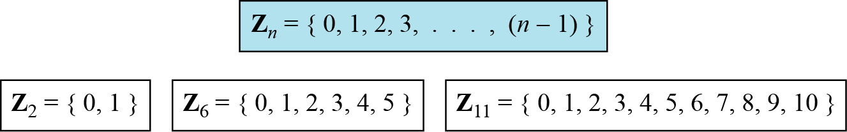
Set of Residues
The modulo operation creates a set, which in modular arithmetic is referred to as the set of least residues modulo n, or Z_{n}.

Slide 6
Congruence (≡ operator)
To show that two integers are congruent, we use the congruence operator ( ≡ ).
It indicates equality in modulus.
2 mod 10= 2
12 mod 10=2
3 mod 5=3
8 mod 5=3

Slide 7
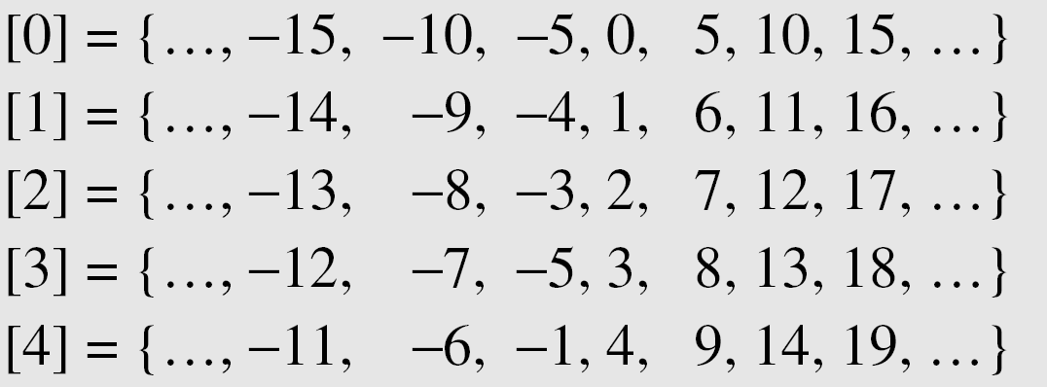
Residue Classes
A residue class [a] or [a]_{n} is the set of integers congruent modulo n.
For example n=5
Z₅={0, 1, 2, 3, 4}
Then we have 5 residue classes.

Slide 8
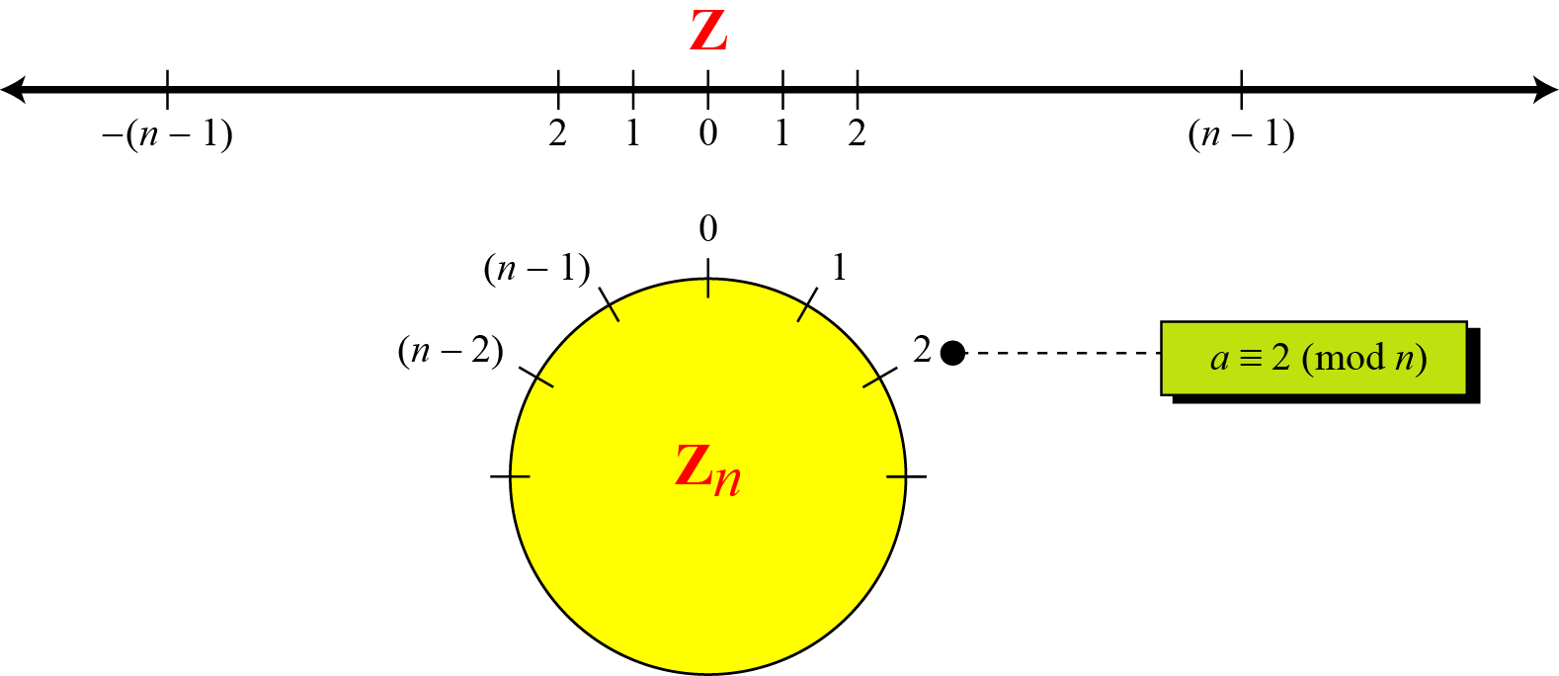
Comparison of Z and Z_{n} using graphs

Slide 9
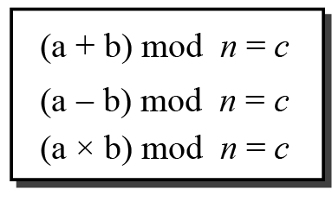
Operation in Z_{n}

Slide 10
Operation in Z_{n}
Perform the following operations (the inputs come from Zn):
Add 7 to 14 in Z₁₅.
Subtract 11 from 7 in Z₁₃.
Multiply 11 by 7 in Z₂₀.

Slide 11
Z_{n} Operation properties

Slide 12
Z_{n} Operation properties
The following shows the application of the above properties:
(1,723,345 + 2,124,945) mod 11 = (8 + 9) mod 11 = 6
(1,723,345 − 2,124,945) mod 16 = (8 − 9) mod 11 = 10
(1,723,345 × 2,124,945) mod 16 = (8 × 9) mod 11 = 6

Slide 13
Inverses
In modular arithmetic, we often need to find the inverse of a number.
Additive Inverse
Multiplicative Inverse

Slide 14

Additive Inverse
In Z_{n}, two numbers a and b are additive inverses of each other if
The sum of an integer and its additive inverse is congruent to 0 modulo n.
In modular arithmetic, each integer has an additive inverse.

Slide 15
Additive Inverse
Find all additive inverse pairs in Z₁₀.
The six pairs of additive inverses are (0, 0), (1, 9), (2, 8), (3, 7), (4, 6), and (5, 5).

Slide 16

Multiplicative Inverse
In Z_{n}, two numbers a and b are the multiplicative inverse of each other if
When it does, the product of the integer and its multiplicative inverse is congruent to 1 modulo n.
The number ‘a’ has multiplicative inverse in Z_{n} if and only if
gcd (n, a) = 1.
In modular arithmetic, an integer may or may not have a multiplicative inverse.

Slide 17
Multiplicative Inverse
Find the multiplicative inverse of 8 in Z₁₀.
As gcd (10, 8) = 2 ≠ 1 , number 8 has no multiplicative inverse in Z₁₀.
Find all multiplicative inverses in Z₁₀.
There are only three pairs: (1, 1), (3, 7) and (9, 9).
The numbers 0, 2, 4, 5, 6, and 8 do not have a multiplicative inverse. As gcd with 10 is not equal to 1.

Slide 18
Euclidean Algorithm to find GCD
Fact 1: gcd (a, 0) = a
Fact 2: gcd (a, b) = gcd (b, r), where r is the remainder of dividing a by b
Fact 1: if second number is 0 then gcd is first number.
Fact 2: change values of a and b until b becomes 0.
gcd(36,10)=gcd(10,6)=gcd(6,4)=gcd(4,2)=gcd(2,0)=2

Slide 19
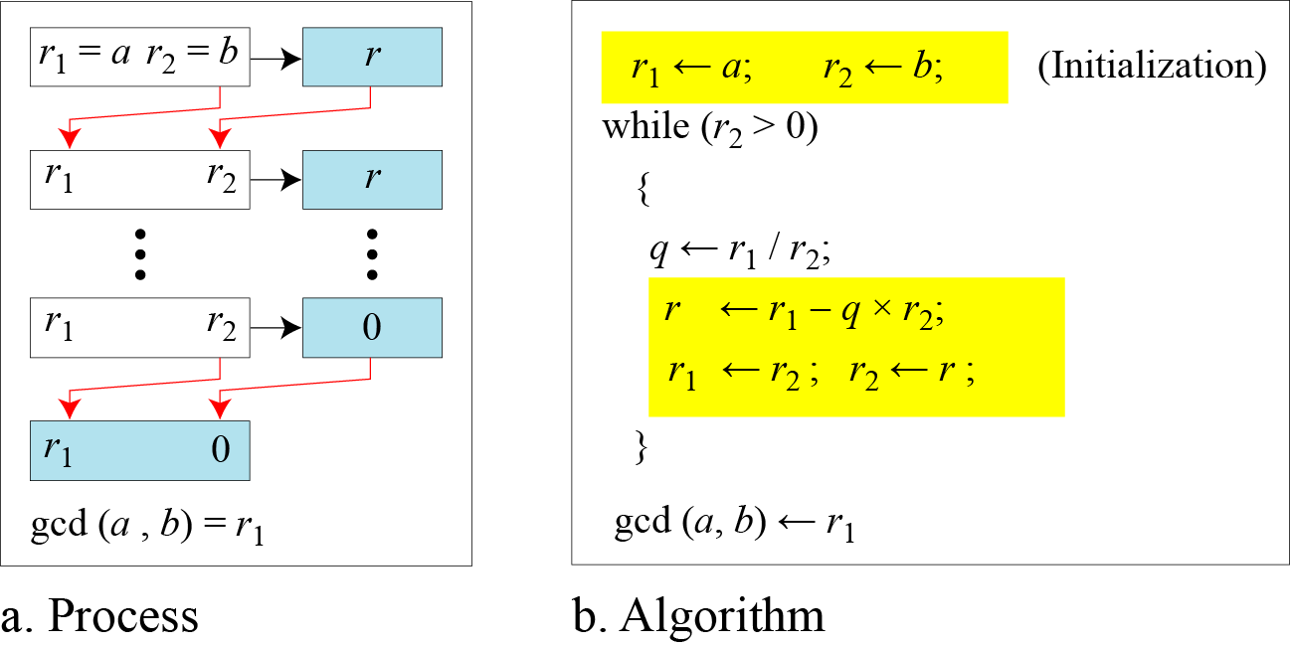
Euclidean Algorithm to find GCD
When gcd (a, b) = 1, we say that a and b are relatively prime.

Slide 20

Extended Euclidean Algorithm
Given two integers a and b, we often need to find other two integers, s and t, such that
The extended Euclidean algorithm can calculate the gcd (a, b) and at the same time calculate the value of s and t.

Slide 21
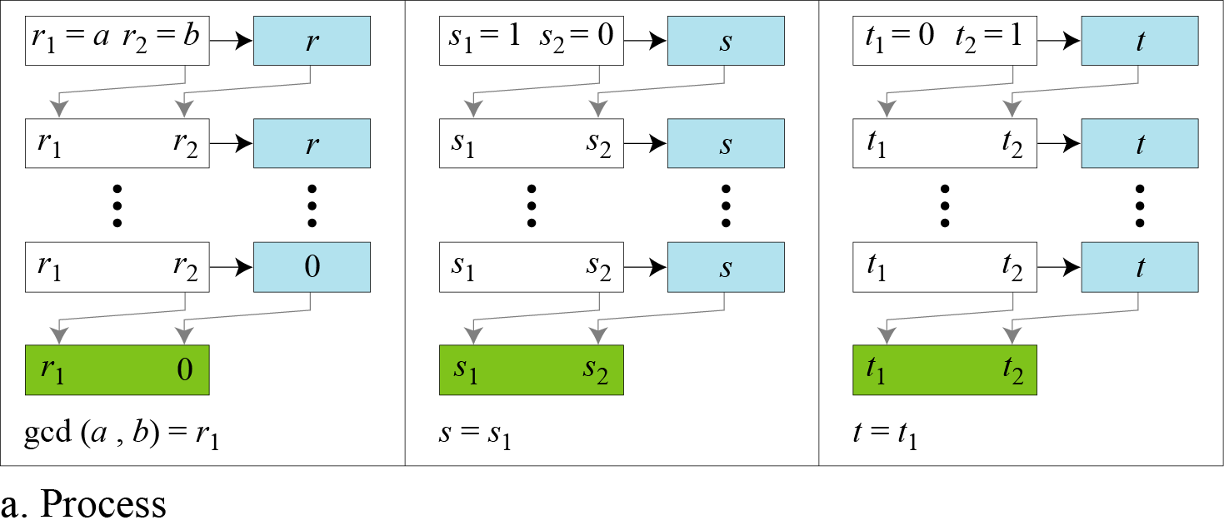
Extended Euclidean Algorithm

Slide 22
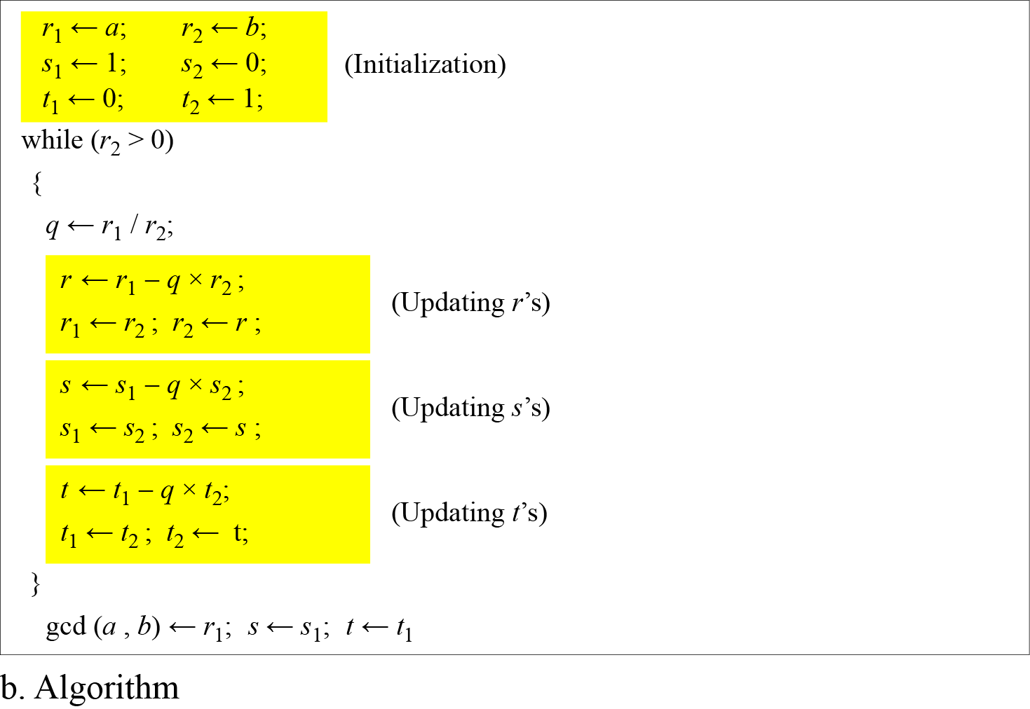
Extended Euclidean Algorithm

Slide 23
Extended Euclidean Algorithm
Example 1:
Given a = 161 and b = 28, find gcd (a, b) and the values of s and t.
gcd (161, 28) = 7, s = −1 and t = 6.

Slide 24
Extended Euclidean Algorithm
Example 2:
Given a = 17 and b = 0, find gcd (a, b) and the values of s and t.

Slide 25
Extended Euclidean Algorithm
Example 2:
Given a = 17 and b = 0, find gcd (a, b) and the values of s and t.
gcd (17, 0) = 17, s = 1, and t = 0.

Slide 26
Multiplicative Inverse using Extended Euclidean Algorithm
The extended Euclidean algorithm finds the multiplicative inverses of ‘b’ in Z_{n} when n and a are given and gcd (n, b) = 1.
The multiplicative inverse of ‘b’ is the value of t after being mapped to Z_{n}.

Slide 27
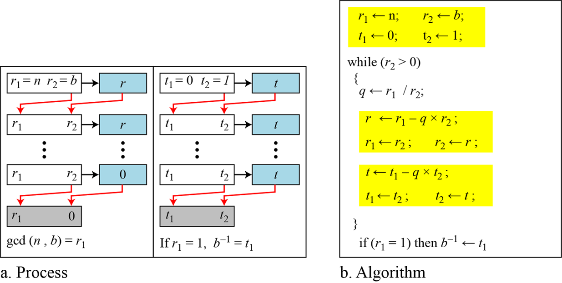
Multiplicative Inverse using Extended Euclidean Algorithm

Slide 28
Multiplicative Inverse using Extended Euclidean Algorithm
Find the multiplicative inverse of 11 in Z₂₆.
n=r1=26
B=r2=11
The gcd (26, 11) is 1; the inverse of 11 is −7 or 19.

Slide 29
Multiplicative Inverse using Extended Euclidean Algorithm
Find the multiplicative inverse of 23 in Z₁₀₀.
n=r1=100
b=r2=23
The gcd (100, 23) is 1; the inverse of 23 is −13 or 87.

Slide 30
Multiplicative Inverse using Extended Euclidean Algorithm
Find the inverse of 12 in Z₂₆.

Slide 31
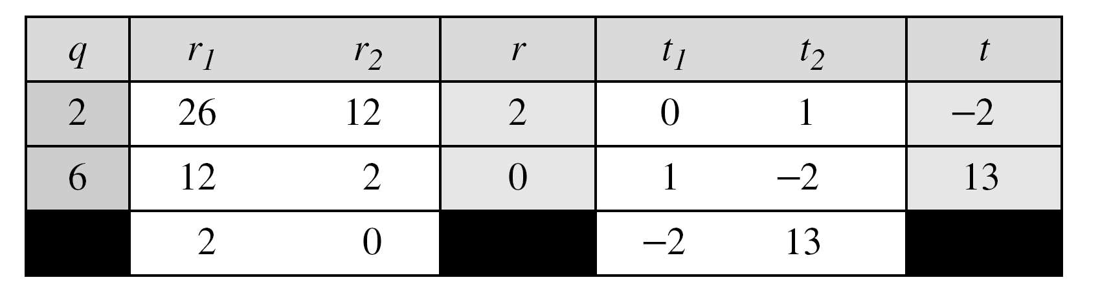
Multiplicative Inverse using Extended Euclidean Algorithm
Find the inverse of 12 in Z₂₆.
The gcd (26, 12) is 2; the inverse does not exist.

Slide 32
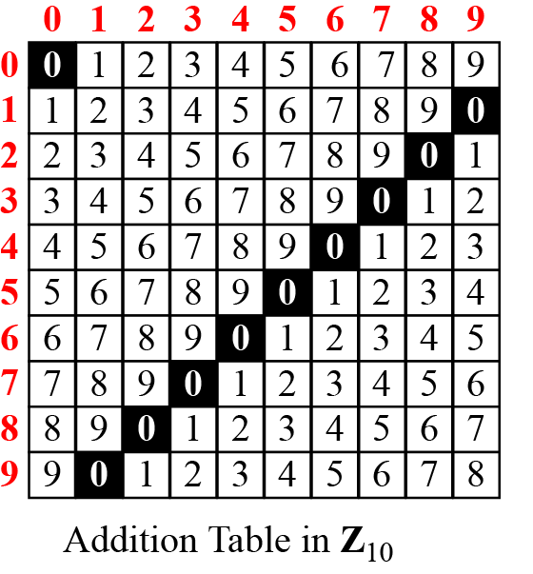
Addition and Multiplication Tables
Addition table for Z₁₀
Check row and column of element 0, they are additive inverse to each other in Z_{10.}
(0,0) , (1,9) , (2,8) , (3, 7) , (4, 6) , (5, 5) , (6, 4) , (7, 3) , (8, 2) , (9, 1)

Slide 33

Addition and Multiplication Tables
Multiplication table for Z₁₀
Check row and column of element 1, they are multiplicative inverse to each other in Z_{10.}
(1,1) , (3, 7) , (7, 3) , (9, 9)

Slide 34
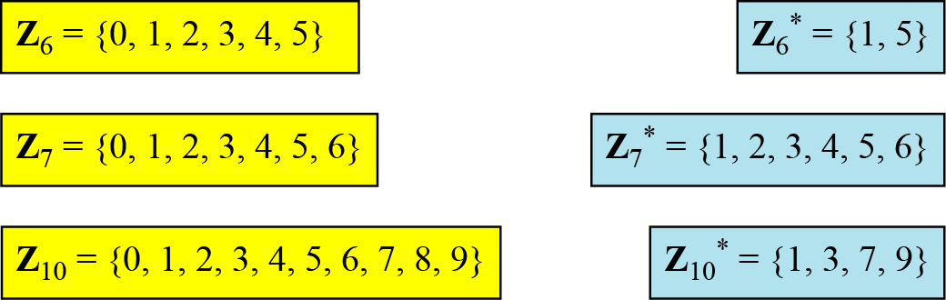
Different Sets : Z_{n} and Z_{n}* sets
Z_{n}= set of additive inverse numbers.
Z_{n}*= set of multiplicative inverse numbers.

Slide 35
Different Sets : Z_{n} and Z_{n}* sets
Find Z₆ and Z₆* sets

Slide 36
Different Sets : Z_{n} and Z_{n}* sets
Find Z₆ and Z₆* sets
Z₆ ={0, 1, 2, 3, 4, 5}
Z₆* ={1, 5}
 | 0 | 1 | 2 | 3 | 4 | 5
0 | 0 | 1 | 2 | 3 | 4 | 5
1 | 1 | 2 | 3 | 4 | 5 | 0
2 | 2 | 3 | 4 | 5 | 0 | 1
3 | 3 | 4 | 5 | 0 | 1 | 2
4 | 4 | 5 | 0 | 1 | 2 | 3
5 | 5 | 0 | 1 | 2 | 3 | 4
 | 0 | 1 | 2 | 3 | 4 | 5
0 | 0 | 0 | 0 | 0 | 0 | 0
1 | 0 | 1 | 2 | 3 | 4 | 5
2 | 0 | 2 | 4 | 0 | 2 | 4
3 | 0 | 3 | 0 | 3 | 0 | 3
4 | 0 | 4 | 2 | 0 | 4 | 2
5 | 0 | 5 | 4 | 3 | 2 | 1
Addition table for Z₆
Multiplication table for Z₆

Slide 37
Two More Sets
Cryptography often uses two more sets: Z_{p} and Z_{p}*.
The modulus in these two sets is a prime number.
Z_{p} ={0, 1, ………, p-1}
Z_{p}* ={1, 2, ………, p-1}

Slide 38
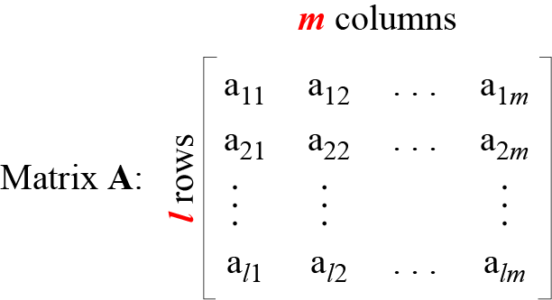
MATRICES
A matrix of size l × m

Slide 39
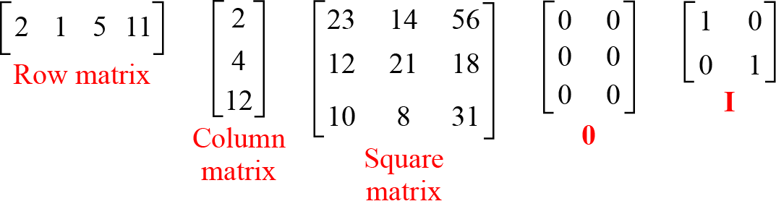
Examples of matrices

Slide 40
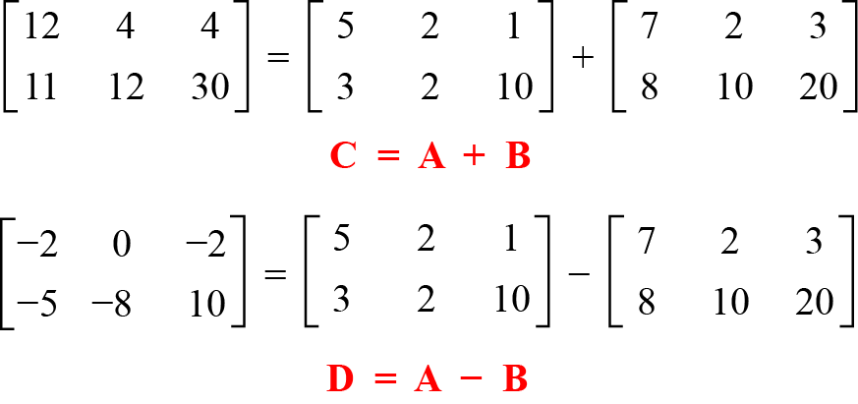
Matrix Addition and Subtraction

Slide 41
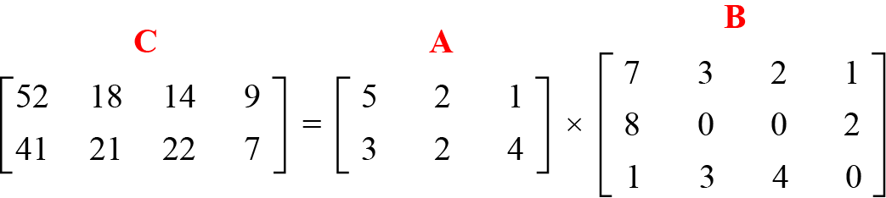
Matrix Multiplication
Product of a 2 × 3 matrix by a 3 × 4 matrix.
The result is a 2 × 4 matrix.

Slide 42
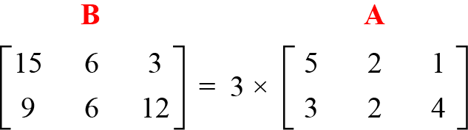
Scalar multiplication of Matrix

Slide 43
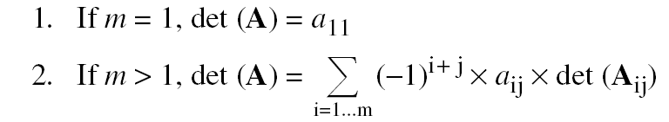
Determinant of Matrix
The determinant is defined only for a square matrix.
The determinant of a square matrix A of size m × m denoted as det (A) is a scalar calculated recursively as shown below:

Slide 44
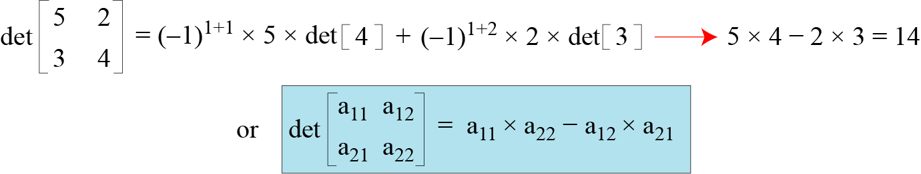
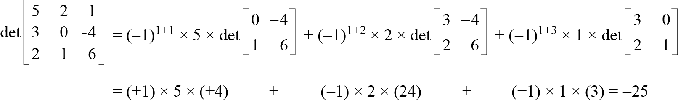
Determinant of Matrix

Slide 45
Inverse of Matrix
Matrices have both additive and multiplicative inverses.
Additive inverse
Additive inverse of matrix A is defined -A .
Additive inverse of matrix A is matrix B, such that A+B=0
Multiplicative Inverse
Multiplicative inverses are only defined for square matrices.
Multiplicative of matrix A is matrix B, such that, A×B = B×A =I

Slide 46
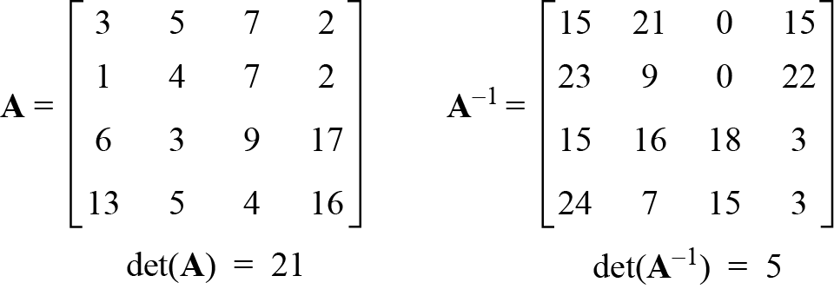
Residue Matrices
Cryptography uses residue matrices: matrices where all elements are in Z_{n}.
Operations on matrix are done in modular arithmetic.
A residue matrix has a multiplicative inverse if gcd (det(A), n) = 1
A residue matrix in Z₂₆ and its multiplicative inverse

Slide 47
LINEAR CONGRUENCE
Cryptography often involves solving an equation or a set of equations of one or more variables with coefficient in Z_{n}.
Single-Variable Linear Equations
Set of Linear Equations

Slide 48

Single-Variable Linear Equations
Equations of the form ax ≡ b (mod n ) might have no solution or a limited number of solutions.

Slide 49
Single-Variable Linear Equations
Steps to find Solution:
Reduce equation by dividing both sides of equation(including modulus) by ‘d’.
Multiply both sides of equation by multiplicative inverse of ‘a’ to find particular solution ‘x₀’.
The general solutions are
x = x₀ +k (n/d) for k=0, 1, ……, (d-1)

Slide 50
Single-Variable Linear Equations
Example 1
Solve the equation 10 x ≡ 2(mod 15).
Solution
First we find the gcd (10 and 15) = 5.
Since 5 does not divide 2, we have no solution.

Slide 51
Single-Variable Linear Equations
Example 2
Solve the equation 14 x ≡ 12 (mod 18).
Solution: d= gcd(a,n) = gcd(14, 18) = 2
Steps to find Solution:
Reduce equation by dividing both sides of equation(including modulus) by ‘d’.
Multiply both sides of equation by multiplicative inverse of ‘a’ to find particular solution ‘x₀’.
The general solutions are
x = x₀ +k (n/d) for k=1, ……, (d-1)

Slide 52
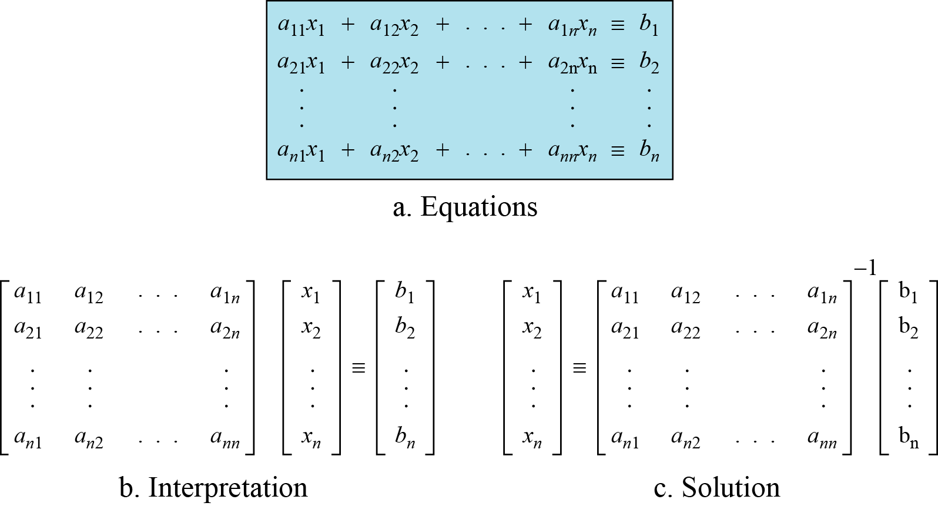
Set of Linear Equations

Slide 53
Example 2.38
Solve the set of following three equations:
Solution
The result is x ≡ 15 (mod 16), y ≡ 4 (mod 16), and z ≡ 14 (mod 16). We can check the answer by inserting these values into the equations.

